Slide 1

AGILE BEST PRACTICE
Rieng Tran

Slide 2

AGENDA
Best Practices
Team Roles
Preparation
Scrum Ceremonies
Retrospective Techniques

Slide 3


BEST PRACTICES - DISCOVERY
Clients to have clarity of the product vision and roadmap
Client involvement (helps make them responsible and accountable for their deliverables): Instead of Architects and BA writing the use stories, have the client involved in write (or reviewing & approving) the user stories along with developers
Estimations to use the thumb rule of “1 story point per person per day” to define expected Sprint Velocity
Two sprints worth of User Stories to be groomed before starting Sprint Cycles. DoR (Definition of Ready) or (Safe to Start) to be defined for each User Story
Acceptance Criteria to be defined at the sprint/ release level but DoD (Definition of Done) to be captured at the User Story level
Product Owner should be "Voice of the customer" and to be regularly and consistently engages with business stakeholders and is accountable for product success

Slide 4
Spring
Client involvement (helps make them responsible and accountable for their deliverables): Invite key client stakeholders to participate in Sprint Planning, Sprint Reviews/ Demo, Retrospective Sessions. Follow-through on important items over email after each session.
Schedule Product Backlog Refinement sessions regularly with sufficient time to maintain backlog of 2 sprints worth of ready user stories (1-2 per week for 2 hours)
Sprint Duration to be not less than 2 weeks and not more than 4 weeks
User Stories not to be updated for an existing Sprint, instead update Product backlog and bring the new requirement as part of new User Story in a new Sprint
User Stories to be consistent and have the framework covering “Who->What->Why”
Maximum duration of a User Story in a Sprint should be 1/2 a Sprint
Daily Stand-up Meeting to be for 15min only and to be scheduled at the same time daily
Team members to log and track 'Actual hours' and TO DO accurately in the tool. This will serve as input to the daily burndown charts / metrics
Create a "Bug" subtask within the user story. All the defects / review comments can be logged in the bug subtask and linked to the user story

Slide 5

ENGAGEMENT BILLING TYPE
Agile 'Fixed fee' engagement type to be committed only if 'Capacity’ and ‘Scope’ is known and estimated.
There are 2 options:
"Discovery Phase" can be T&M where the scope gets defined and frozen while the future "Sprint Phase" can be Fixed Fee
"Discovery Phase" can be Fixed Fee if client is not clear with the scope while the future "Sprint Phase" can be T&M to accommodate changing requirements as part of future backlogs sprints

Slide 6
ESTIMATIONS - RELATIVE ESTIMATION
Estimate features using t-shirt sizing, user stories in story points, and tasks in hours
T-shirt sizing (XS, S, M, L, XL) is an effective way of removing the element of time from the level of effort.
Story point estimating is done during PBR as the user story is further detailed. Story points represent relative measure of size or complexity of a story, based on a modified Fibonacci sequence; collaborative estimation techniques like planning poker drive discussion and consensus on the work that needs to be done
Task estimation in hours is done during sprint planning by team committing to delivering it & is based upon the actual effort each task is expected to consume
Develop estimation guidelines for scrum teams so that estimates are generally consistent from one team to the next

Slide 7
TEAM CAPACITY
Total number of hours each team member is available to work on backlog items during the upcoming sprint
Initially calculated during discovery and revisited in sprint planning
Considers holidays, PTO, training, conferences, etc.
Capacity = total FTE days in the sprint x ideal hours
Ideal hours guideline is ~6 hours/day to allow time for meetings, overhead, non-sprint work

Slide 8
TEAM VELOCITY
Estimated total number of story points a scrum team can be expected to complete in a sprint. Used to plan for sprint
Estimate thumb rule for expected Sprint Velocity: 1 story point per person per day
Calculated as the rolling average of the velocity from the previous 3 sprints – as this can keep changing based on project dynamics
Velocity should not be compared with other teams
While a Team's velocity will oscillate from Sprint to Sprint, over time, a well-functioning Scrum Team's velocity should steadily trend upward by roughly 10% each Sprint till the curve stabilizes. It also facilitates very accurate forecasting of how many stories a Team can do in a Sprint..

Slide 9
TEAM ROLES
Project Manager (PM) | Scrum Master
Accountable for the project execution and therefore performs a project execution oversight to help the teamwork towards overall project success Accountable for the financial tracking, reporting and invoicing Accountable for availability of project code in Oracle Manage the resourcing of the project (planning and acquisition) Tracking and reporting of utilization of team members Team logistics (resourcing, travel, accommodation) and expenses Identifies and manages risks and issues on the project Serves as a consistent point of contact for Client | Coaches the team on Agile Track the team progress, and run the daily team stand up Manage sprints to ensure the team work as efficiently as possible Leads the team towards continuous improvement Removes impediments of scrum team Protects the team from uncontrolled work expansion Communicates with other programme teams, especially the business Supports estimating Facilitates meetings and creates rigour Facilitates preparation and readiness for events Forecasts deliverables, meetings and project milestones.

Slide 10
Architect | Delivery Manager | DevOps
Operates at a high level with requirements and business vision to deliver detailed architecture and solutions that leverage the chosen technologies as required by Client Produce and maintain the system architecture document through the lifetime of the project Presents the solution design to TDA Supports integration with experience of integrating new & legacy systems Supports the development teams with guidance on design Ensures the solution developed does not break any architectural principles set in place as part of the initial design Analysis/designs required solutions to fulfil the breadth of nonfunctional requirements | Collaborates with Scrum Master and PO to deliver releasable features Owns multi-disciplinary technical delivery strands and coordinate releases in parallel Removes impediments Ensures quality of features built Ensures alignment across all scrum delivery streams Ensures effective communication within the teams Oversight of (but not responsibility for) the development team in checking that solutions are built to an appropriate level of quality | Analysis/Design for environments impacted by user stories Implement pipeline tasks and scripts to support deployment of all developed artefacts, dependent services and infrastructure Ensure the technical aspects and integrations are functioning for getting a release from development to production Ensures that version control is applied. Monitor DevOps pipelines for efficiency improvements and respond to failures. Documentation of automation and orchestration processes Responsible for applying a level of governance and security measures

Slide 11
Business Analyst (BA) | Product Owner (PO)
Works with PO to take solution requirements agreed and elaborate into software requirements to be provided to development team. Develops epics, features and user stories based on the requirements. Qualifies requirements. Identify and progress backlog items to a state of “ready” in preparation for the next sprint. Supports the validation of the product backlog during the project development. Runs workshops and training sessions | Work with business users to understand the business requirements, production issues and other questions Own the product backlog and prioritize requirements with business users Validates requirements against expected level of detail for development Admits requirements to sprint backlog Supports BA in refinement of user stories when required Manages client stakeholders
Developer lead
Lead developers team to make appropriate technical decisions in the design of their software against requirements with a close focus on Definition of Done. Own low-level design of system components Own technical delivery of the solution, and oversight of development, being responsible for adherence to design Resolve technical blockers Identify needs for technical conversations and arrange sessions between key stakeholders Be primary contact for development team on day-to-day basis Assist Project Manager with plan and progress reviews, highlighting risks and issues Escalation for Early Life Support (where requested)

Slide 12
Development team | Test Lead | Test Team
Participate in sprint planning, collaborate with PO to refine user stories and acceptance criteria. Own sprint backlog Provide daily work progress in the daily stand-up meetings Research, design, prototyping and other exploration activities Responsible for the development of the designed solution and implementation, writing code that conforms to the definition of done. Write unit tested code and check new code into the shared source code repository. Participate in the Scrum ceremonies as required | Lead the test team and co-ordinate testing against plan Analysis of requirements & design in order to review testing scope Defines test strategy and creates test plan Develop test artefacts namely: scenarios, scripts, cases data Coordinate test execution and test scripting Defect creation, analysis and management Ensures acceptance criteria have been met before proceeding to next environment/phase Monitors and reports on test progress Point of contact for testing and QA | Participate in sprint planning, collaborate with PO to refine user stories and acceptance criteria. Provide Daily test progress in the daily stand-up meetings. Analyze the user stories to understand the test scenarios and test cases needed to be created and executed. Execute acceptance cases and maintain the test cases in a shared repository. Design, develop and execute functional acceptance test scripts. Design, develop and execute automated acceptance test scripts. Support the Test Lead with the detailed information for test results and reporting Participate in the Scrum ceremonies as required.

Slide 13

The way to get started is to quit talking and begin doing.
Walt Disney

Slide 14




PREPARATION
Don’t take longer than a week.
• Do keep it lightweight and avoid big design principles.
• Don’t do more than is expressly needed for the first sprint to have a successful kickoff.
• Do work together as a team and emphasize a culture of team building. ​
Why preparation?
• Product Owner and the team needs to get along well
• Environments to not exist
• Processes are not clear
• Definition of Ready and Done are not defined
• Sprint Agenda is unsure

Slide 15
PREPARATION -> CHECK LIST
HR | Environments | Technical | Process
• Evaluate Scrum knowledge level of all team members • Are client Stakeholders aware of their role and their available time? • Is team trained for technologies that will be used in the project? • Is team aware and capable to be cross-functional? | All team members have the necessary software installed? • All team members have all needed accesses sorted? • Are servers configured are ready to be used? • Are meeting facilities set up? All team members are aware of what is needed to schedule calls and perform video conferences? • Is the Version Control system setup? All team members have the minimum knowledge? • Are the project online workspace configured and aligned with the Scrum process? (e.g. Azure DevOps, JIRA, etc.) | Definition of code conventions among development team • Definition of version control rules among development team • Is the base architecture clear to all team members? • Definition of test strategy ‒ TDD approach? ‒ Unit tests code coverage goal ‒ Type of testing needed: manual, automated, security, performance • Is the deploy process clear to all team members? | Craft a team name • Agree ways of working with the client ‒ Sprint duration ‒ Sprint ceremonies ‒ Project stakeholders ‒ The result should be an approved document that will be valid for all the project • Agree about the Definition of Ready • Agree about the Definition of Done Start the creation of the Product Backlog (if not exists already) • Sprint 1 refinement session • Build a story pointing matrix ‒ Technique to help the team estimate each future story ‒ Consists in having general terms around each story that helps on the estimation process ‒ Base story

Slide 16


CEREMONIES
Daily Standup | Sprint Planning | Backlog Refinement

Slide 17

DAILY STANDUP
Quickly inform everyone of what's going on across the team. Each team member answer the following questions:
‒ What did I complete yesterday?
‒ What will I work on today?
‒ Am I blocked by anything?
Input: Updated Sprint Backlog
Duration: 15 minutes.
Outputs: Identification of blockers
Who?
▪ Dev team
▪ Scrum Master
▪ PO / BA [optional]
▪ Architect [optional]

Slide 18
PLANS THE WORK TO BE PERFORMED IN A SPRINT. ANSWERS THE FOLLOWING: ‒ WHAT CAN BE DELIVERED IN THE INCREMENT RESULTING FROM THE UPCOMING SPRINT? ‒ HOW WILL THE WORK NEEDED TO DELIVER THE INCREMENT BE ACHIEVED?
Sprint Planning
Input: Prioritized Product Backlog
Duration: Max. 4h for 2-week sprint
- 2h for commitment
- 2h for task forecasting
Outputs:
Sprint goal
Sprint backlog
Who?
▪ PO / BA
▪ Scrum Master
▪ Dev Team
▪ Architect

Slide 19

BACKLOG REFINEMENT
Review items on the backlog
‒ Remove user stories no longer relevant.
‒ Create new user stories in response to newly needs.
‒ Assign estimates to stories which have yet to receive one.
‒ Correct estimates in light of recently discovered information.
Input: Product Backlog
Duration: Max. 2h for 2-week sprint
Outputs: Updated Product Backlog
Who?
▪ Dev team
▪ PO / BA
▪ Scrum Master [optional]
▪ Architect [optional]

Slide 20
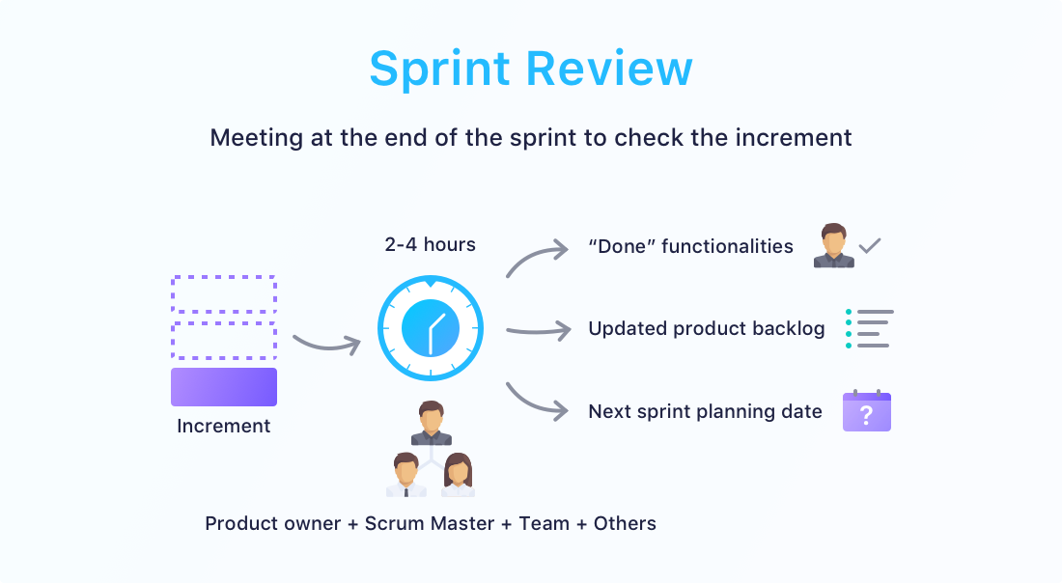

Slide 21
AGILE TESTER
Agile Software Development | Fundamental Agile Testing Principles, Practices, and Processes | Agile Testing Methods, Techniques

Slide 22
OVERVIEW
Agile Software Development
Agile Manifesto – 4 statements of values
Individuals and interactions over processes and tools
Working software over comprehensive documentation
Customer collaboration over contract negotiation
Responding to change over following a plan
Fundamentals of Agile Software Development
Aspects of Agile approaches
Fundamental Agile Testing Principles, Practices, and Processes
The Differences between Testing in Traditional and Agile Approaches
Status of Testing in Agile Projects
Role and Skills of a Tester in an Agile Team
Agile Testing Methods, Techniques, and Tools
Agile Testing Methods
2 Assessing Quality Risks and Estimating Test Effort
Techniques in Agile Projects
Tools in Agile Projects

Slide 23
AGILE MANIFESTO – 12 PRINCIPLES
Our highest priority is to satisfy the customer through early and continuous delivery of valuable software.
Welcome changing requirements, even late in development. Agile processes harness change for the customer's competitive advantage.
Deliver working software frequently, at intervals of between a few weeks to a few months, with a preference to the shorter timescale.
Business people and developers must work together daily throughout the project.
Build projects around motivated individuals. Give them the environment and support they need, and trust them to get the job done.
The most efficient and effective method of conveying information to and within a development team is face-to-face conversation.
Working software is the primary measure of progress.
Agile processes promote sustainable development. The sponsors, developers, and users should be able to maintain a constant pace indefinitely.
Continuous attention to technical excellence and good design enhances agility.
Simplicity—the art of maximizing the amount of work not done—is essential.
The best architectures, requirements, and designs emerge from self-organizing teams.
At regular intervals, the team reflects on how to become more effective, then tunes and adjusts its behavior accordingly.

Slide 24


WHOLE-TEAM APPROACH
Involving everyone having knowledge & skills necessary to ensure project success. Includes customer representatives, business stakeholders. 3 – 9 people, ideally, share the same work space/ co-location to facilitates communication & interaction. Supported through daily stand-up meeting
Benefits:
Enhancing communication and collaboration within the team
Enabling the various skill sets within the team to be leveraged to the benefit of the project
Making quality everyone’s responsibility
Tester ensures desired quality levels are achieved by:
Include supporting & collaborating with business representatives to help creating suitable acceptance tests
Working with developers to agree on the testing strategy
Deciding on test automation approaches
Thus can transfer & extend testing knowledge to other team members & influence
The power of three concept: involving testers, developers, & business representatives in all feature discussions

Slide 25
EARLY AND FREQUENT FEEDBACK
Benefits:
Avoiding requirements misunderstandings, which may not have been detected until later in the development cycle when they are more expensive to fix.
Clarifying customer feature requests, making them available for customer use early. This way, the product better reflects what the customer wants.
Discovering (via continuous integration), isolating, and resolving quality problems early.
Providing information to the Agile team regarding its productivity and ability to deliver.
Promoting consistent project momentum.

